Slide 1
Uncertainty Quantification

Slide 2
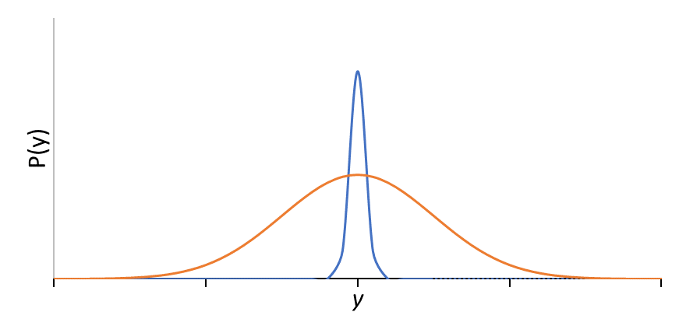
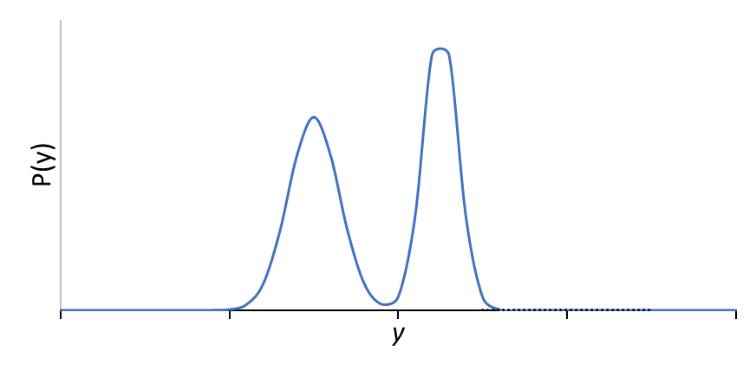
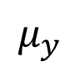
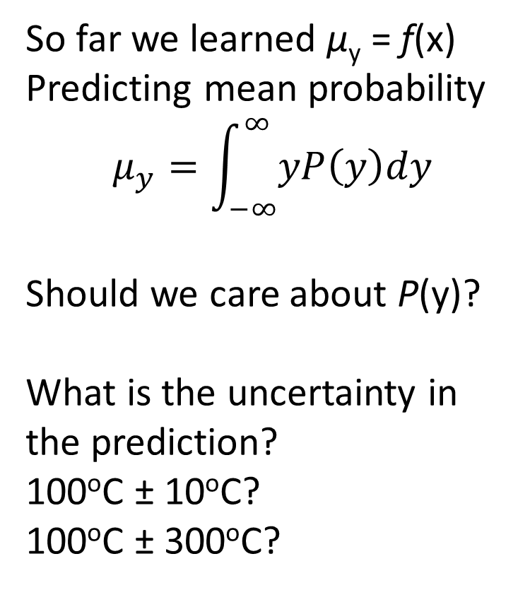
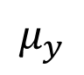
Uncertainty in Prediction
So far we learned μ_{y} = f(x)
Predicting mean probability
$$μ_{y}=\int_{−∞}^{∞}{yP\left(y\right)dy}$$
Should we care about P(y)?
What is the uncertainty in the prediction?
100ºC ± 10ºC?
100ºC ± 300ºC?
$$μ_{y}$$
Normal dist. with low variance.
Mean is a good representation.
Normal dist. with high variance.
Mean is a bad representation.
$$μ_{y}$$
Bimodal distribution.
Mean is a terrible representation.

Slide 3
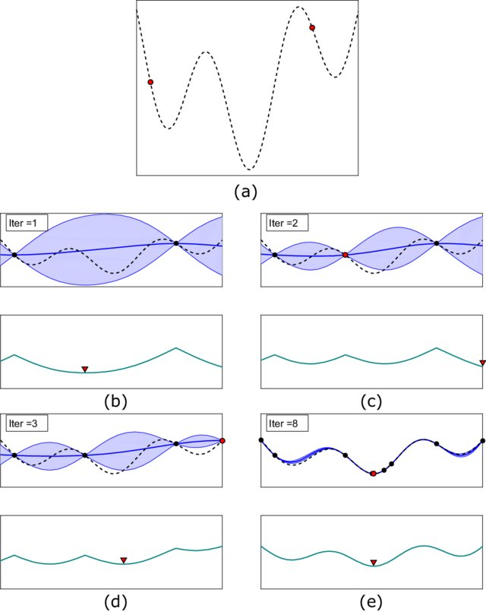
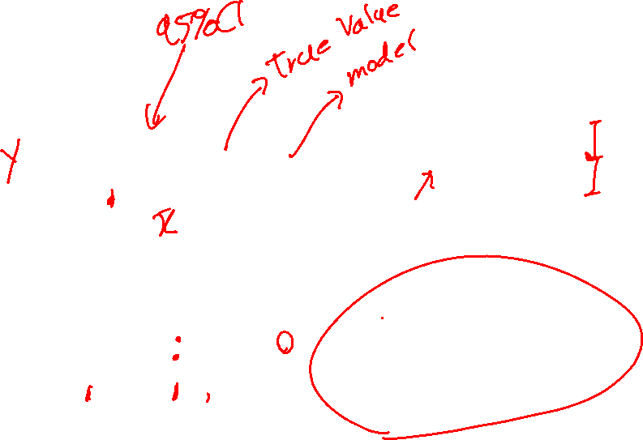
Active Learning-Exploration
Sample points with highest uncertainty.
Smart, efficient sampling
Structural and Multidisciplinary Optimization, 2021, 3, 19076

Slide 4
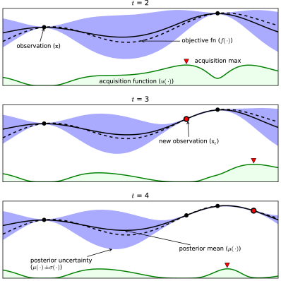
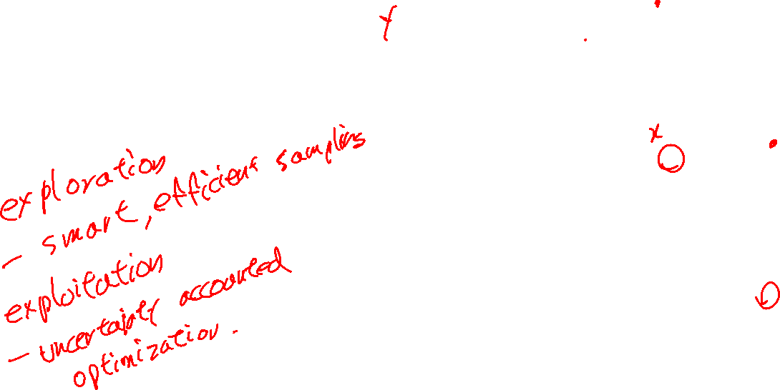
Active Learning-Exploitation
Sample potential highest points by considering uncertainty
Optimizing for the best
https://arxiv.org/abs/1012.2599

Slide 5
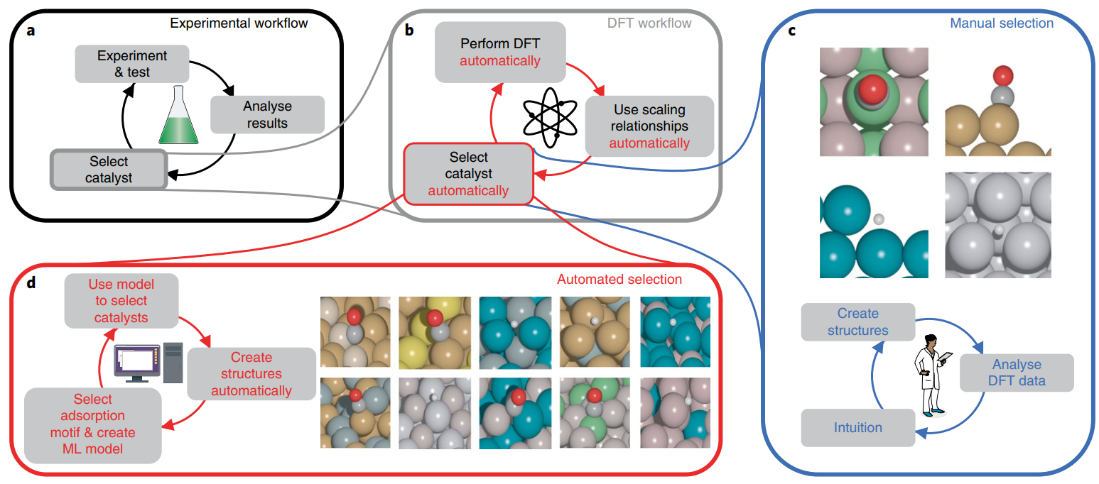
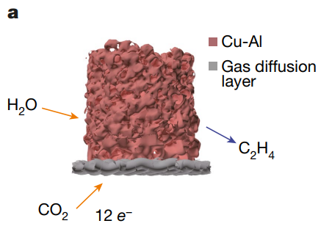
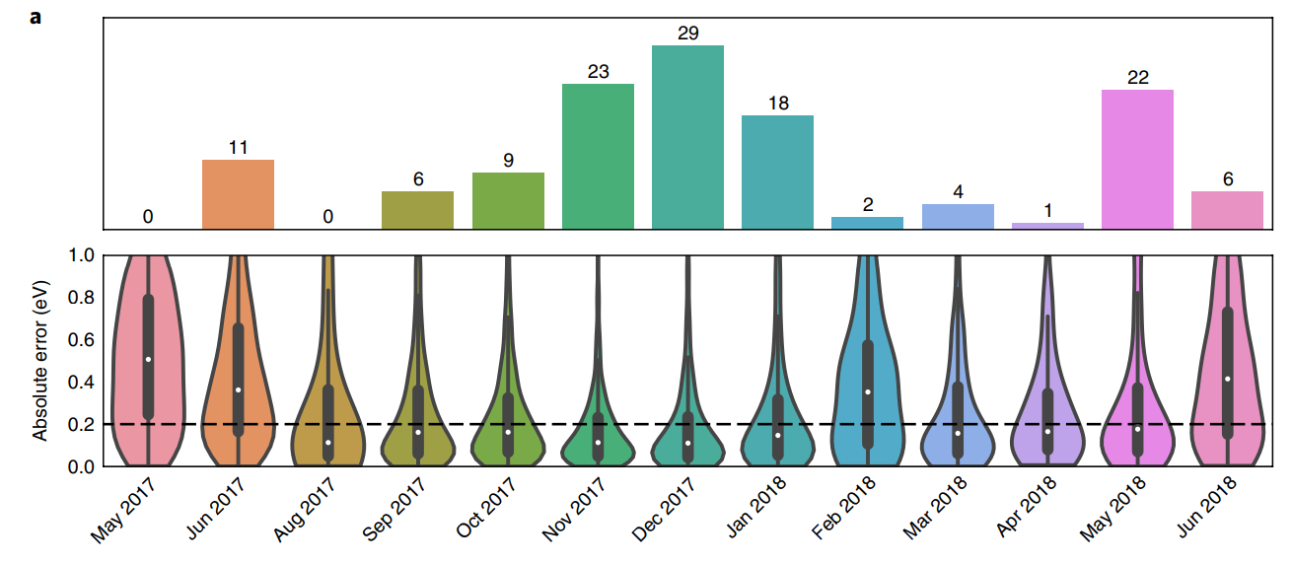
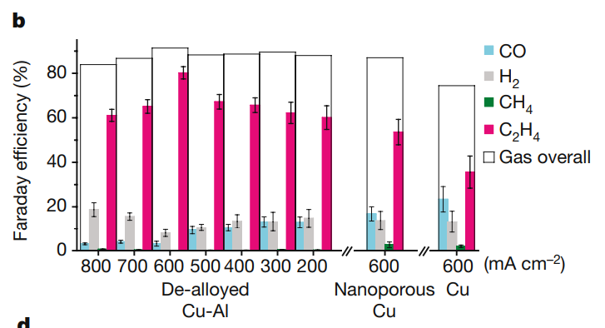
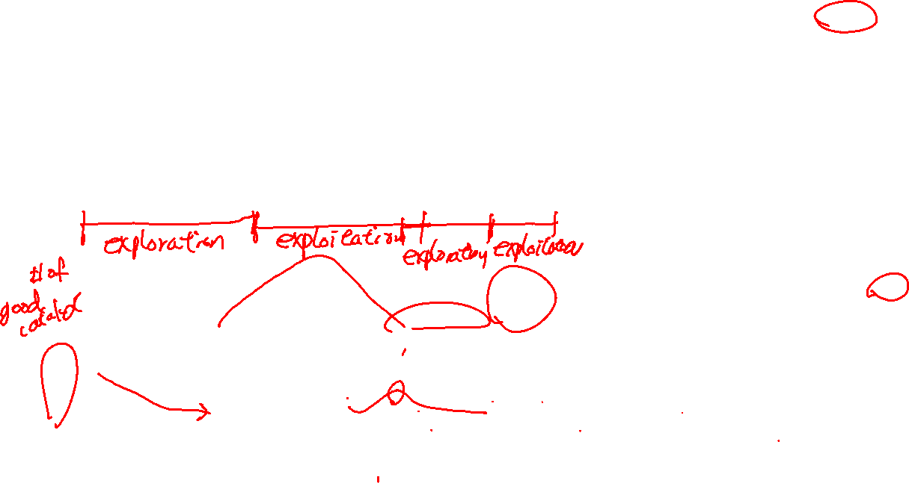
Nature 2020, 581, 178

Slide 6
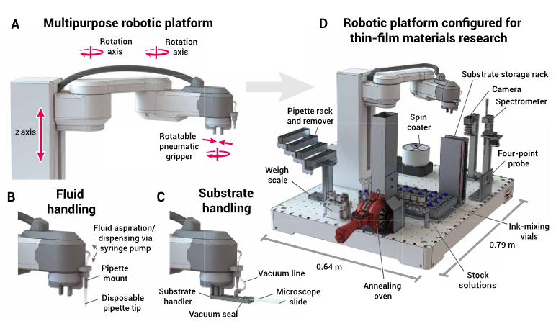
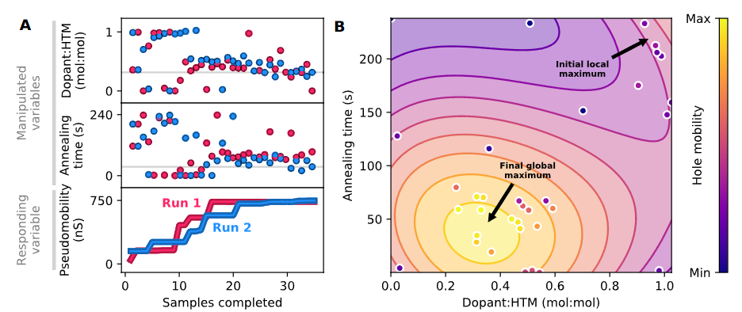
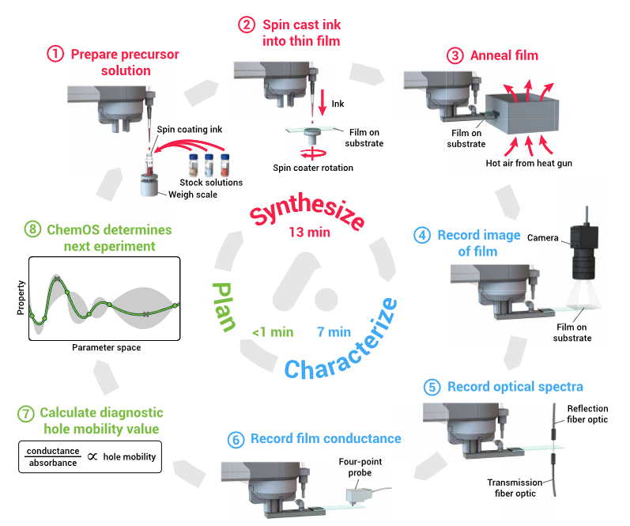
Sci. Adv. 2020, 6, eaaz8867

Slide 7
Gaussian Process

Slide 8
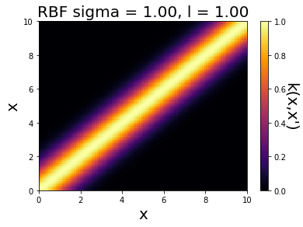
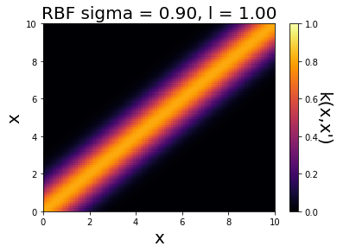
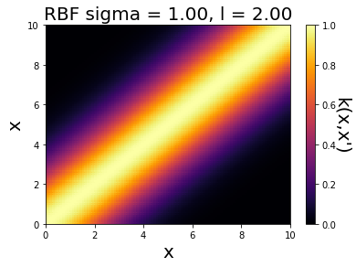
Kernel
A function that measures the similarity of two inputs, x and x’
$$k(x,x^{′}|τ)$$
where $τ$ is a hyperparameters for tuning
Popular kernel is the Radial Basis Function, RBF
$$k\left(x,x^{′} | σ,l\right)=σ^{2}exp⁡\left(−\frac{1}{2}{\left(\frac{x−x^{′}}{l}\right)}^{2}\right)$$
Intuitively, similar the x, and x’, the higher the value

Slide 9
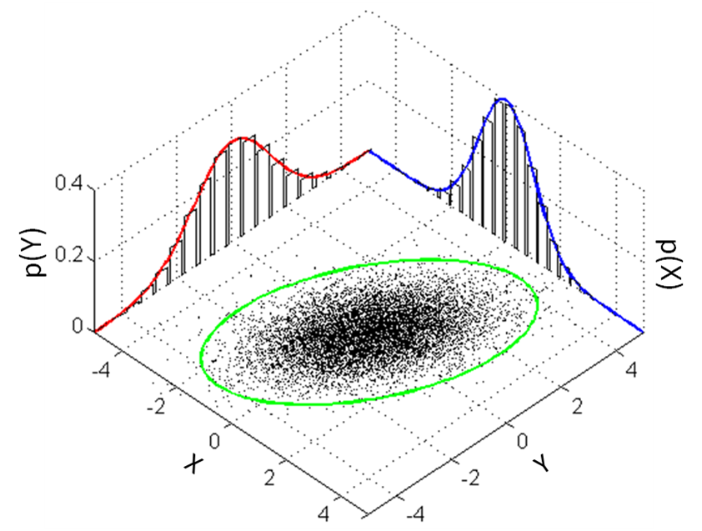
Gaussian Process Assumption
X : training set feature vectors
X* : test set feature vectors
y: training set true value
f: training set prediction
f*: test set prediction
Multivariate normal distribution
Gaussian Process Assumption
$$\left[\begin{matrix}y \\ f^{∗}\end{matrix}\right]\sim N\left(\left[\begin{matrix}0 \\ 0\end{matrix}\right],\left[\begin{matrix}k′(x,x) & k′(x,x^{∗}) \\ k′(x^{∗},x) & k′(x^{∗},x^{∗})\end{matrix}\right]\right)$$
$$k^{′}\left(x,x\right)=k\left(x,x\right)+σ_{ε}^{2}I$$
$$y_{i}=f\left(x_{i}\right)+ε_{i} ε_{i}\sim N(0,σ_{ε}^{2})$$
Gaussian Process Prediction
$$f^{∗}|X^{∗}\sim N(k\left(x^{∗},x\right)k^{′−1}\left(x,x\right)y,k\left(x^{∗},x^{∗}\right)−k\left(x^{∗},x\right)k^{′−1}\left(x,x\right)k\left(x,x^{∗}\right))$$

Slide 10
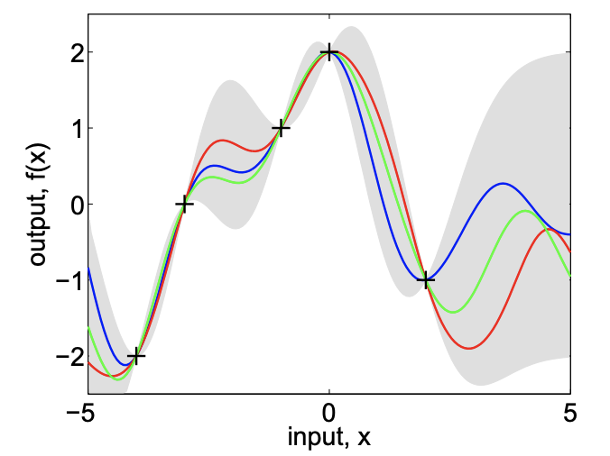
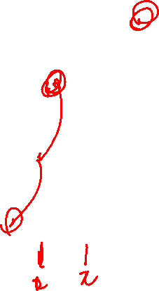
Gaussian Process

Slide 11
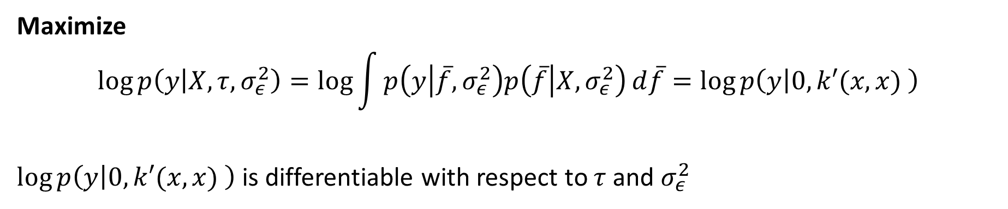

Hyperparameter Selection
Maximize
$$\log{p\left(y | X,τ,σ_{ε}^{2}\right)}=\log{\int{p\left(y | \overline{f},σ_{ε}^{2}\right)p\left(\overline{f} | X,σ_{ε}^{2}\right)}d\overline{f}}=\log{p\left(y | 0,k′(x,x) \right)}$$
$\log{p\left(y | 0,k′(x,x) \right)}$ is differentiable with respect to $τ$and $σ_{ε}^{2}$
Neural Network
Train
Validation
Test
Gaussian Process
Train
Test

Slide 12
Pros and Cons
Pros
Very easy to predict uncertainty
Go to for most of uncertainty prediction
Cons
More data = more computation time, as we need to calculate kernel for each training set
Designing kernel and input feature is difficult

Slide 13
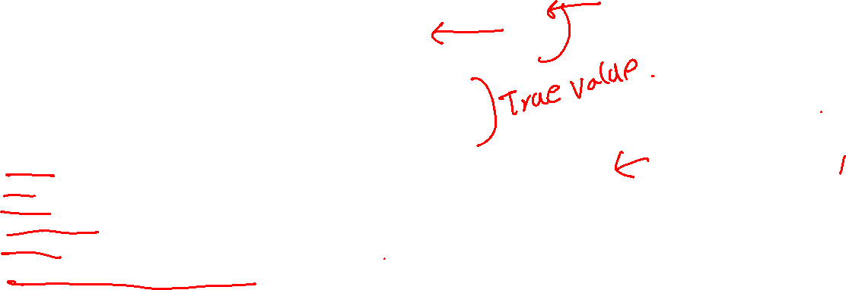
Coding
from sklearn.gaussian_process import GaussianProcessRegressor
from sklearn.gaussian_process.kernels import RBF
import numpy as np
def black_box_function(x):
x = np.array(x)
return -0.1*x ** 3 + 0.2*x**2 + 1 + 2*np.sin(x*3)
kernel = 1.0 * RBF(length_scale=1.0, length_scale_bounds=(1e-1, 1.0))
gpr = GaussianProcessRegressor(kernel=kernel, random_state=0)
x_test = np.linspace(-3,3,500).reshape(-1,1)
x_train = np.array([[-0.5],[0.5]])
y_train = black_box_function(x_train)
gpr.fit(x_train,y_train)

Slide 14
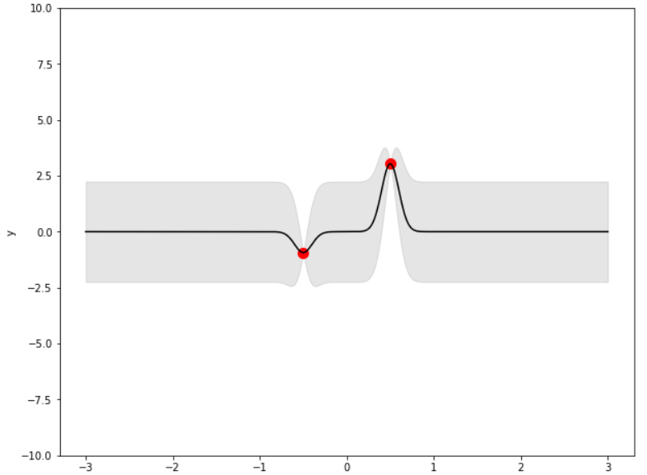
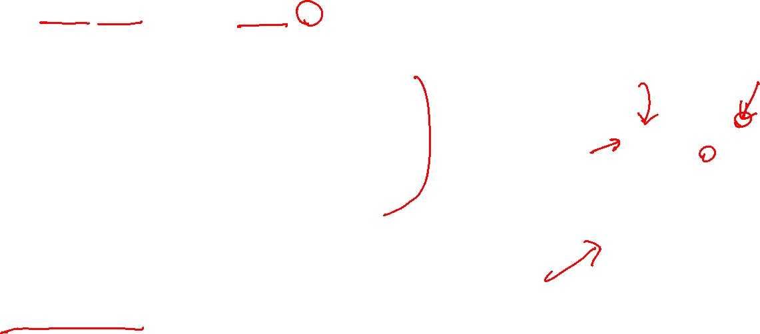
Coding
import matplotlib.pyplot as plt
def plot_gpr_samples(x,gpr_model,x_train,y_train):
fig, ax = plt.subplots(figsize=(10, 8))
y_mean, y_std = gpr_model.predict(x, return_std=True)
x = x.reshape(-1)
y_mean = y_mean.reshape(-1)
ax.plot(x, y_mean, color="black", label="Mean")
ax.fill_between(
x,
y_mean - y_std,
y_mean + y_std,
alpha=0.1,
color="black",
label=r"$\pm$ 1 std. dev.",
)
ax.scatter(x_train,y_train,c='r',s=100)
ax.set_xlabel("x")
ax.set_ylabel("y")
ax.set_ylim([-10, 10])
plot_gpr_samples(x_test,gpr,x_train,y_train)

Slide 15
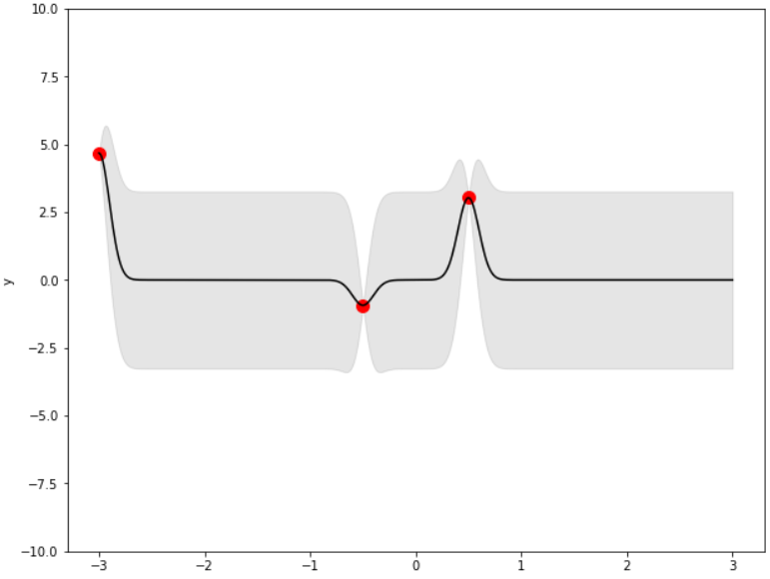
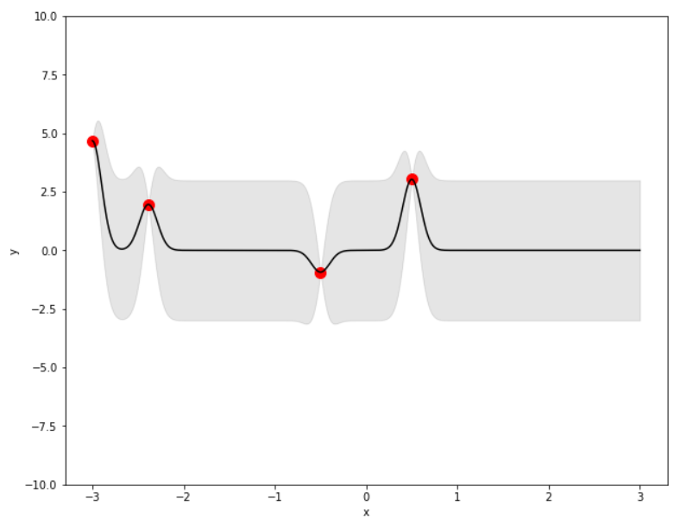
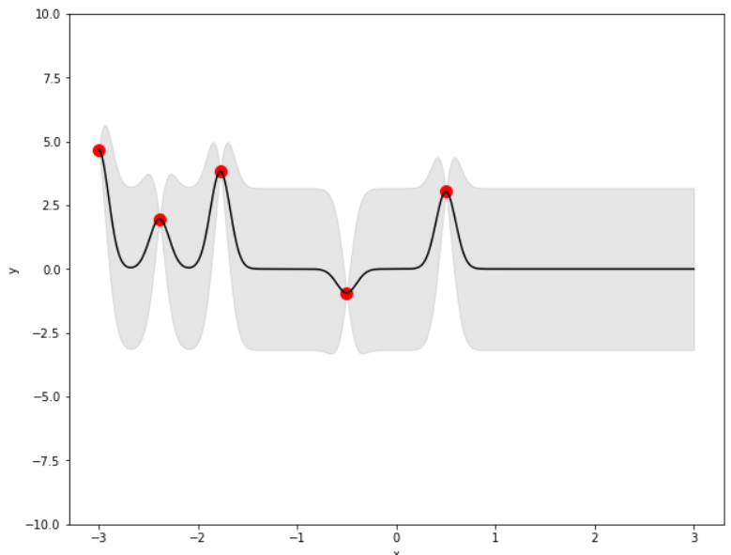
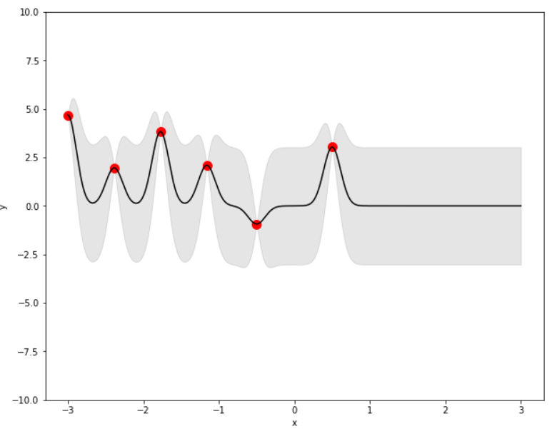
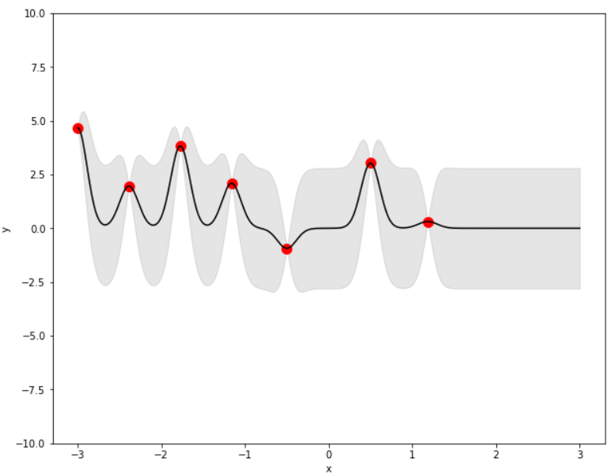
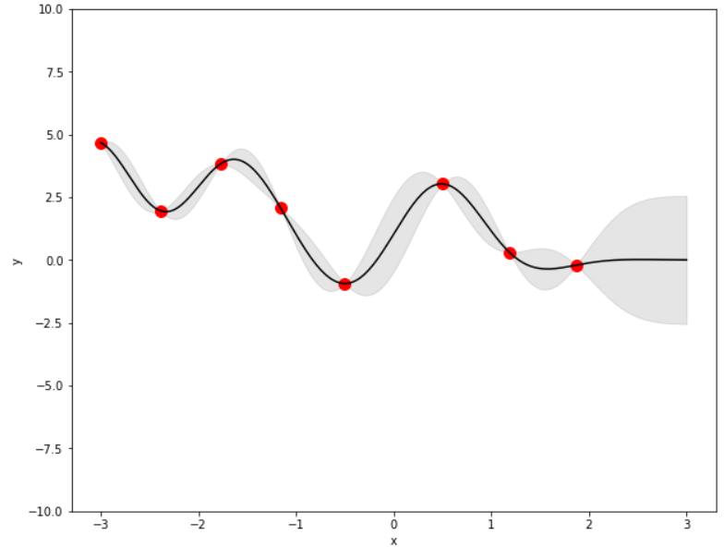
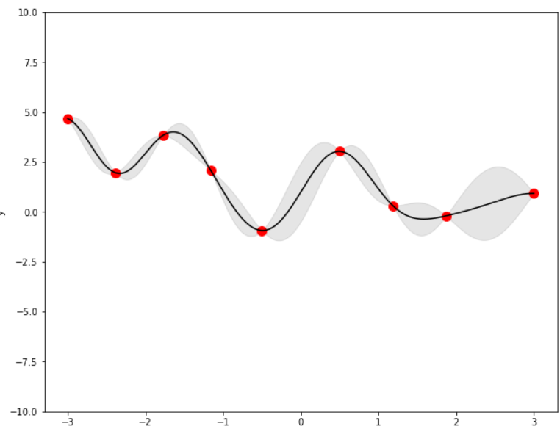
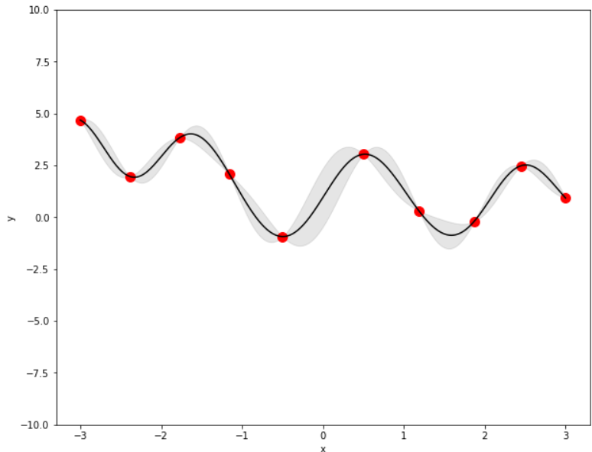
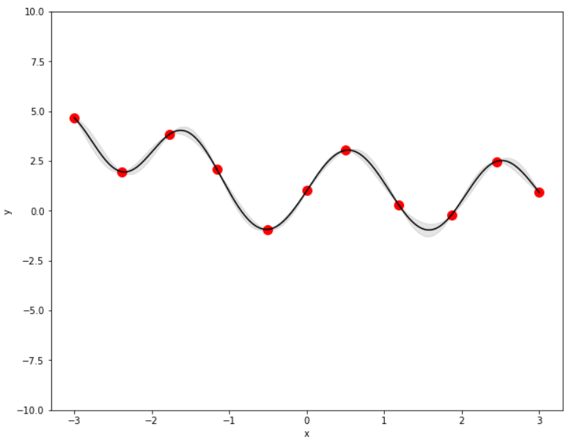
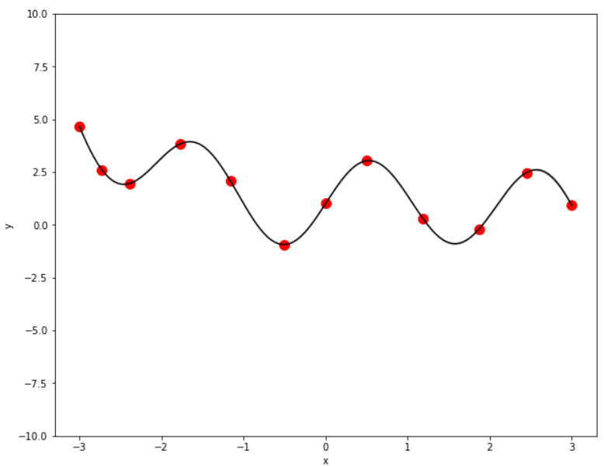
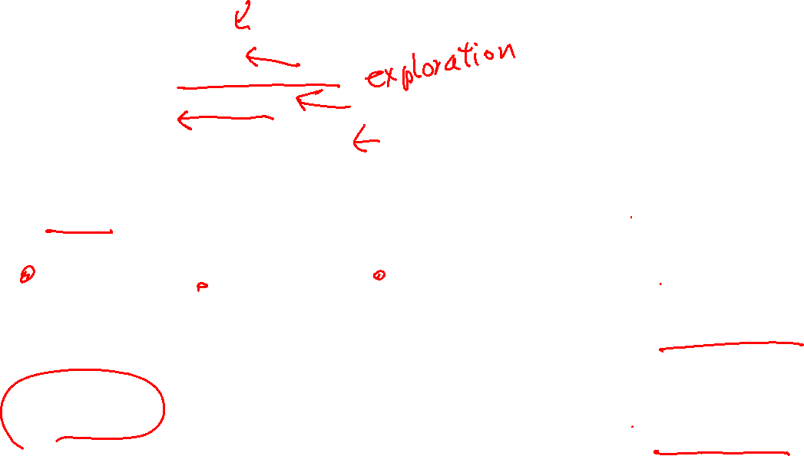
Coding
def addpoint(gpr,x_train,x_test):
y_mean, y_std = gpr.predict(x_test, return_std=True)
x_new = x_test[np.argmax(y_std)]
x_train = np.concatenate((x_train,[x_new]))
y_train = black_box_function(x_train)
gpr.fit(x_train,y_train)
plot_gpr_samples(x_test,gpr,x_train,y_train)
return x_train
for _ in range(10):
x_train = addpoint(gpr,x_train,x_test)

Slide 16
Bayesian Learning

Slide 17
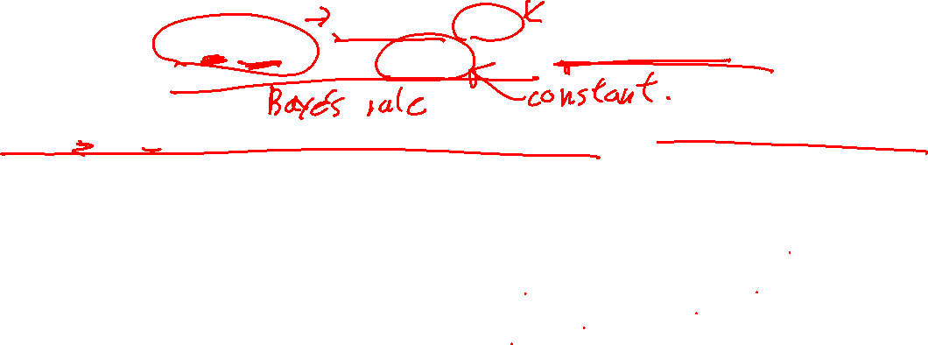
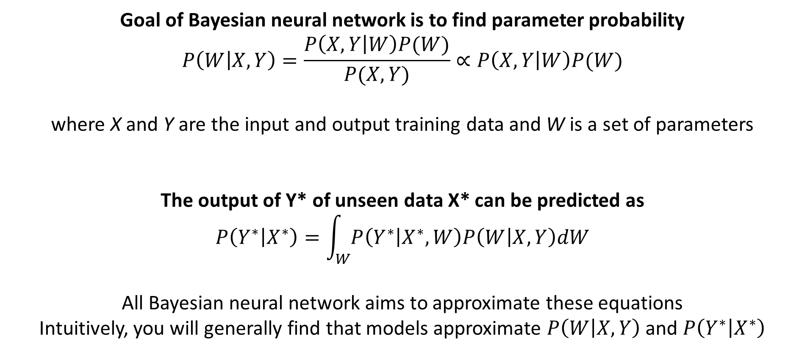
Bayesian Neural Network
Goal of Bayesian neural network is to find parameter probability
$$P\left(W | X,Y\right)=\frac{P\left(X,Y | W\right)P(W)}{P(X,Y)}∝P\left(X,Y | W\right)P(W)$$
where X and Y are the input and output training data and W is a set of parameters
The output of Y* of unseen data X* can be predicted as
$$P\left(Y^{∗} | X^{∗}\right)=\int_{W}^{ }{P\left(Y^{∗} | X^{∗},W\right)P\left(W | X,Y\right)dW}$$
All Bayesian neural network aims to approximate these equations
Intuitively, you will generally find that models approximate $P\left(W | X,Y\right)$ and $P\left(Y^{∗} | X^{∗}\right)$

Slide 18
Dropout Neural Network
Standard Neural Network
Dropout Neural Network. Monte Carlo Selection
For each batch, different neurons are activated and trained.
For prediction, several runs are executed with different activated neurons to estimate $P\left(W | X,Y\right)$

Slide 19
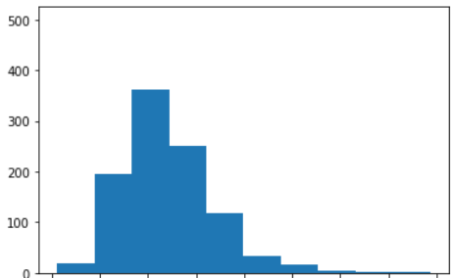
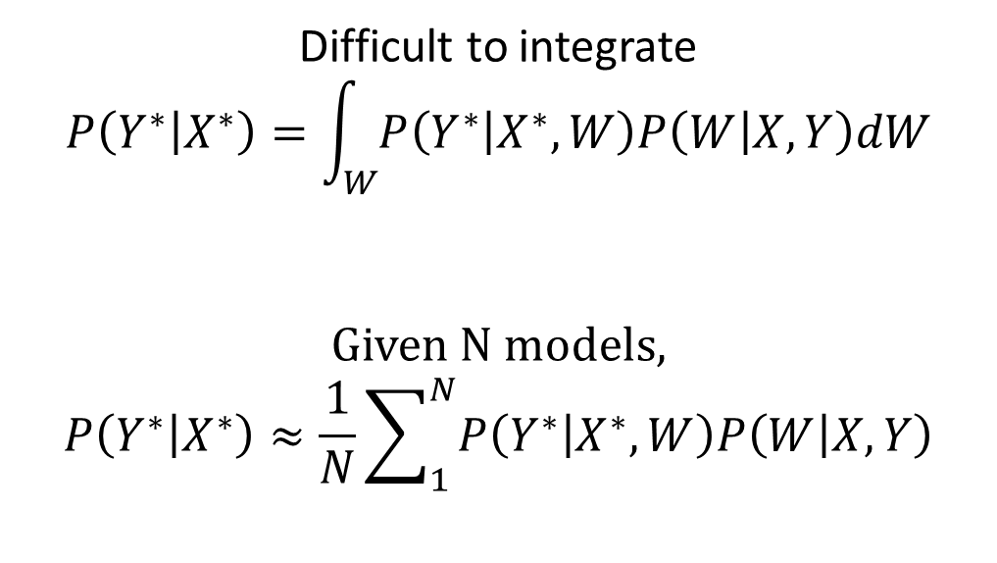
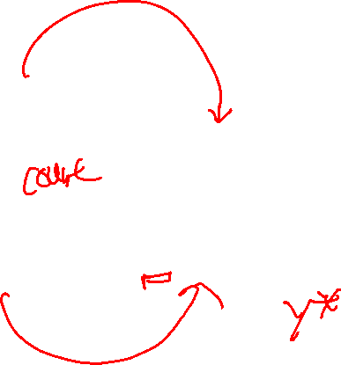
Summation Instead of Integration
Difficult to integrate
$$P\left(Y^{∗} | X^{∗}\right)=\int_{W}^{ }{P\left(Y^{∗} | X^{∗},W\right)P\left(W | X,Y\right)dW}$$
Given N models,
$$P\left(Y^{∗} | X^{∗}\right)≈\frac{1}{N}\sum_{1}^{N}{P\left(Y^{∗} | X^{∗},W\right)P\left(W | X,Y\right)}$$

Slide 20
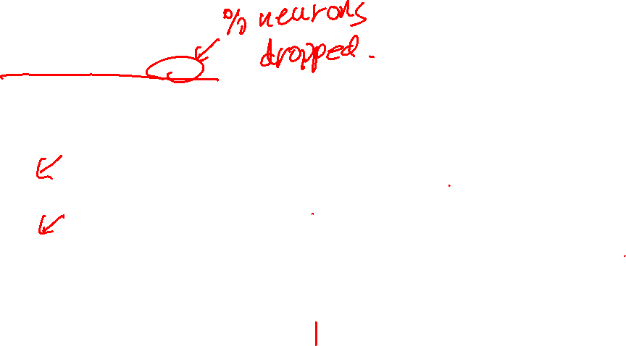
Coding
import torch.nn as nn
class NN(nn.Module):
def __init__(self, input_fea_len, fea_len=64, n_layer=3):
# model initialize. neural network layers
super(NN, self).__init__()
self.act = nn.Softplus()
self.lin1 = nn.Linear(input_fea_len,fea_len)
self.lin2 = nn.Linear(fea_len,fea_len)
self.dropout_layer = torch.nn.Dropout(p=0.5)
self.output_layer = nn.Linear(fea_len, 1)
def forward(self, x):
x = self.lin1(x)
x = self.act(x)
x = self.dropout_layer(x)
x = self.lin2(x)
x = self.act(x)
x = self.dropout_layer(x)
x = self.output_layer(x)
return x

Slide 21
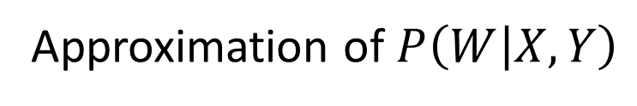

Ensemble Method
Test
Validation
Training
Model 1
Model 2
Model 3
P(Y*)
Model 4
…
Model n
Approximation of $P\left(W | X,Y\right)$

Slide 22
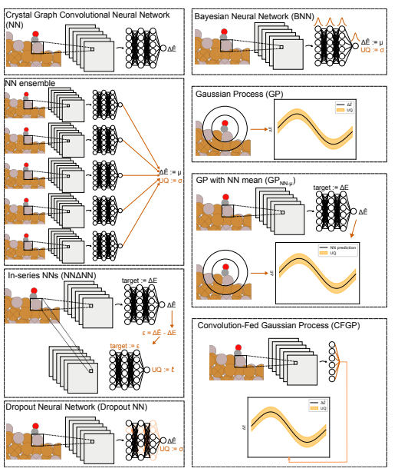
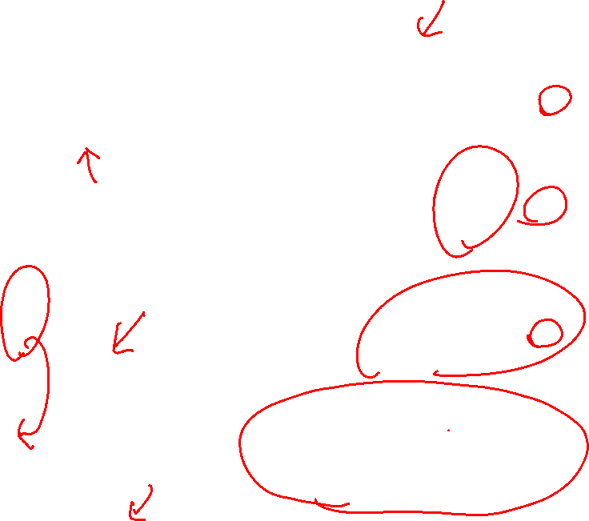
Other Creative Types of Models
Mach. Learn.: Sci. Technol. 1 025006

Slide 23
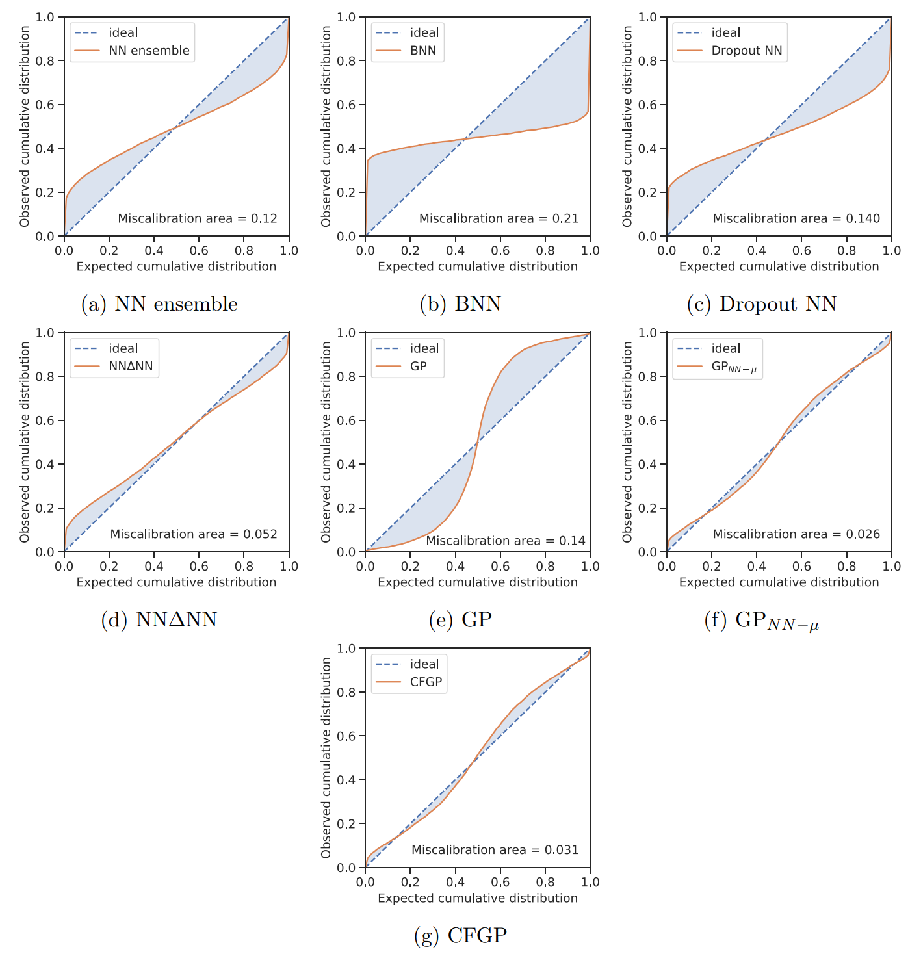
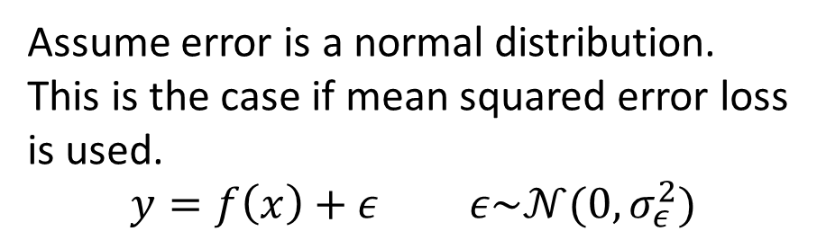
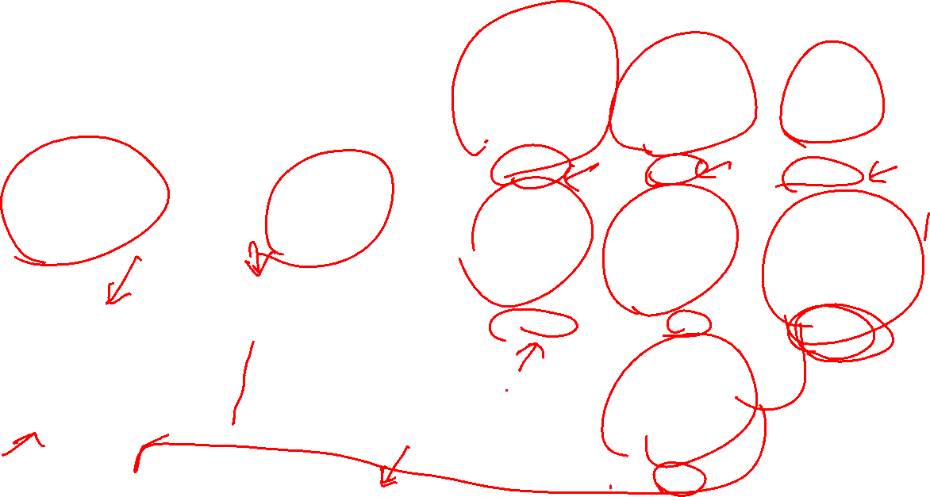
Uncertainty Prediction Comparison
Assume error is a normal distribution.
This is the case if mean squared error loss is used.
$$y=f\left(x\right)+ε ε\sim 𝒩(0,σ_{ε}^{2})$$
Count
Count
error
error
Mach. Learn.: Sci. Technol. 1 025006

